Slide 1

...Construction of the Chinese Traditional Music Culture Knowledge Base (Knowledge Graph in Linked Data) from a “Digital Humanities” Perspective
Junjun Cao
--June
- Invited expert, Library of China Conservatory of Music (Beijing), musicologist of morphology etc.
- Former Postdoctoral Researcher & Linked Data
Scientist for Distributed Digital Music Archive
and Library Laboratory (DDMAL), McGill University
(Montreal)
Slides will be available via GitHub:
[linkedmusic-datalake]
my name is pronounced like month June (phonetically)

Slide 2
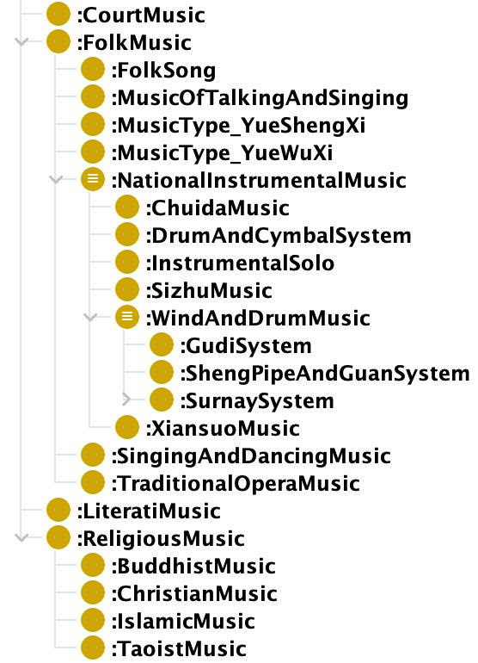
Background 1:Introduction of Chinese Traditional Music Culture
Characteristics of ContemporaryChineseMusicology:
(1) ethnomusicology + (2) Chinese traditionalMusic
morphology -> applied to music composition, blending
Eastern & Western Music flavors
-- 1. classification (top -> bottom)
Chinese Traditional Music Culture, categorized via:
sociological perspective: 4 classes, one of which is
morphological perspective: FolkMusic -> 5 classes
for instrument-associated music (music species
perspective): 7 classes
/ˌlɪtəˈrɑːti/
VocalIntegratedInstrumentalMusicSpecies; DanceIntegratedInstrumentalMusicSpecies;Wind and Percussion Music Species; StringEnsembleMusicSpecies...
--Drew upon the viewpoint of orchestration

Slide 3
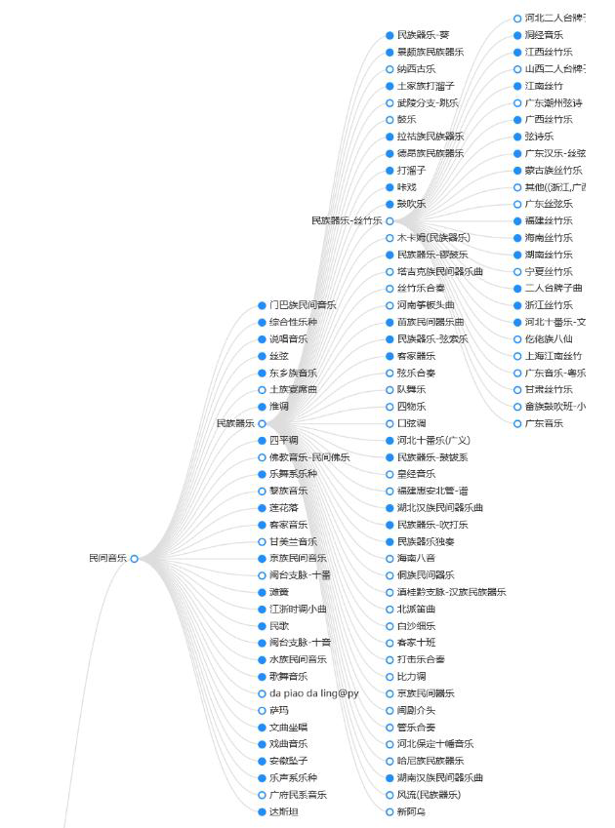
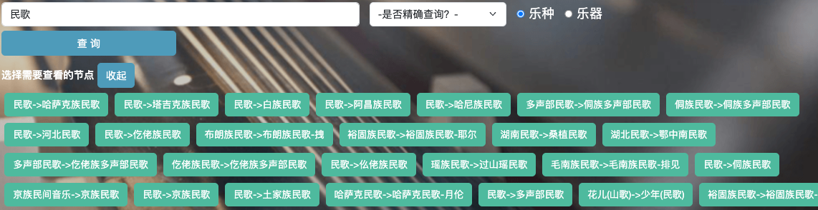
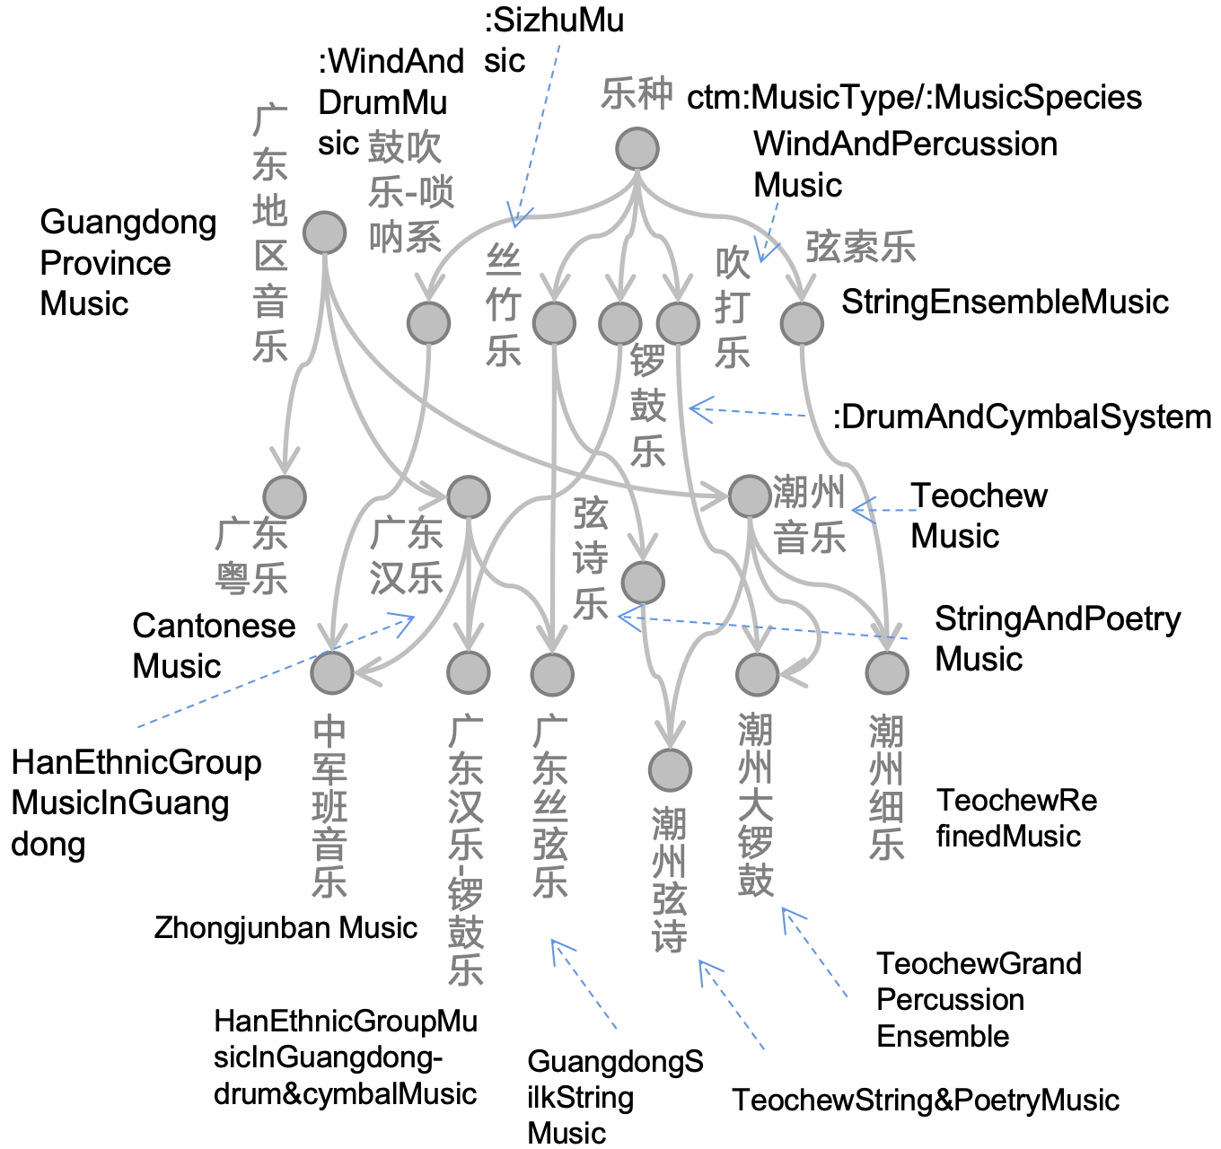
-> directed acyclic structure rather than tree hierarchical structure->
- a child-class may belong to more than
one parent class
- use tree structure
only for display which
will yield redundant
nodes

Slide 4
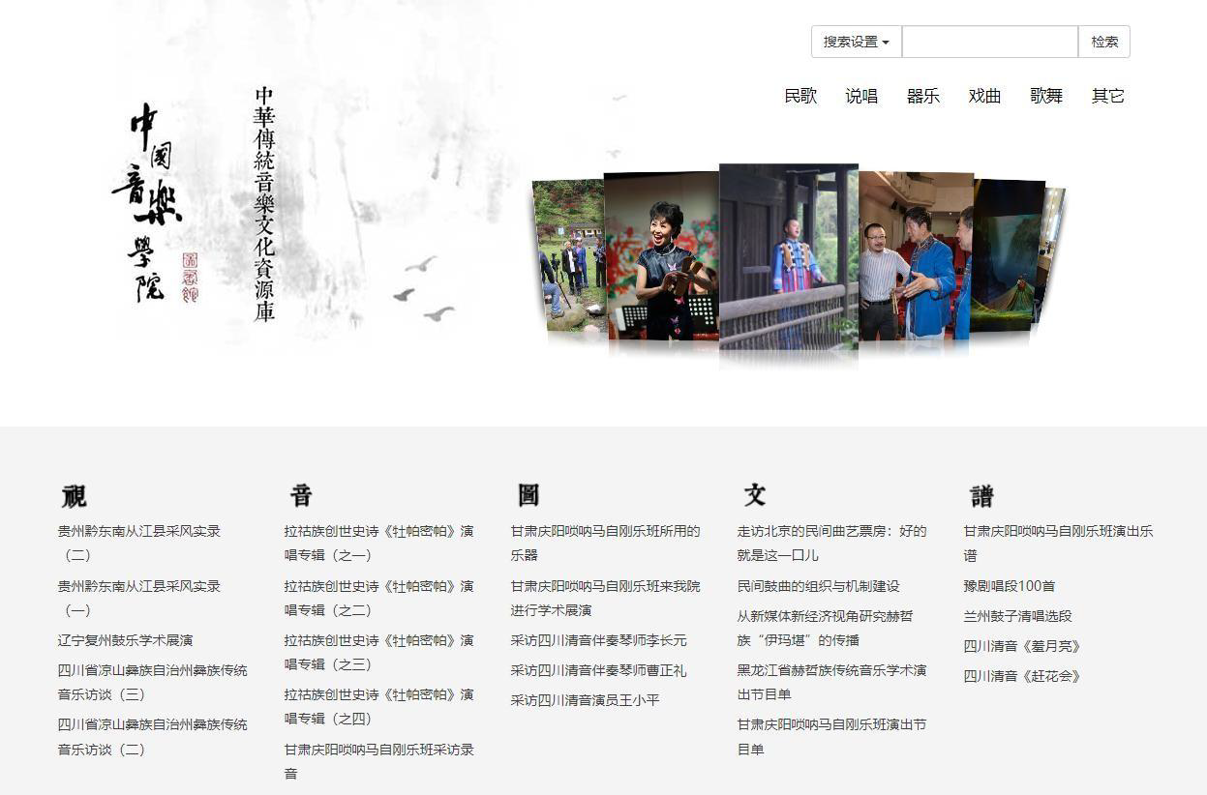

Background 1:Introduction of Chinese Traditional Music Culture
2. cataloging (bottom -> top)
Chinese Traditional Music Culture Resource Warehouse (database)
(1) 20 years old
(2) folk collection and fieldwork, visual ethnography
(3) a “Music Map” vision

Slide 5
Background 2: Technology (and My Research Journey)
lots of following graph instances
tomorrow
1. social network analysis (homogeneous network, Web 2.0) ->
2. knowledge graph (heterogeneous network) in "linked data" format
triples + URI (unified resource identifier) => linked data/RDF
（Resource Descriptive Framework）
Why linked data?
FAIR principle: e.g., especially semantic web (Web 3.0)
3. a semantic turn of knowledge organization:
music metadata -> "metadata ontology"
-> knowledge base (an ontology-driven knowledge graph) that supports intelligent knowledge retrieval,visualization, network analysis...
a normal database ->
Findable,
Accessible,
Interoperable,
Reusable
evolve toward
to be introduced later

Slide 6
Background 3: Digital Humanities
core appeal of digital humanities lies in ...approach
connecting data science to serve humanities
an ideal joint point: structuralism and semiology -[corner stone]
-> focus on text-structuring...with such recognition, to find a common set of digital humanities discourse system (which requires even no mathematics foundation at early stage):
“以知识图谱为体，以元数据本体和网络分析为两翼” (Junjun,2024,Feb)
translation:
- Knowledge graphs serve as the the "body"
- Metadata ontology and network analysis serve as the "two wings":
slogan

Slide 7
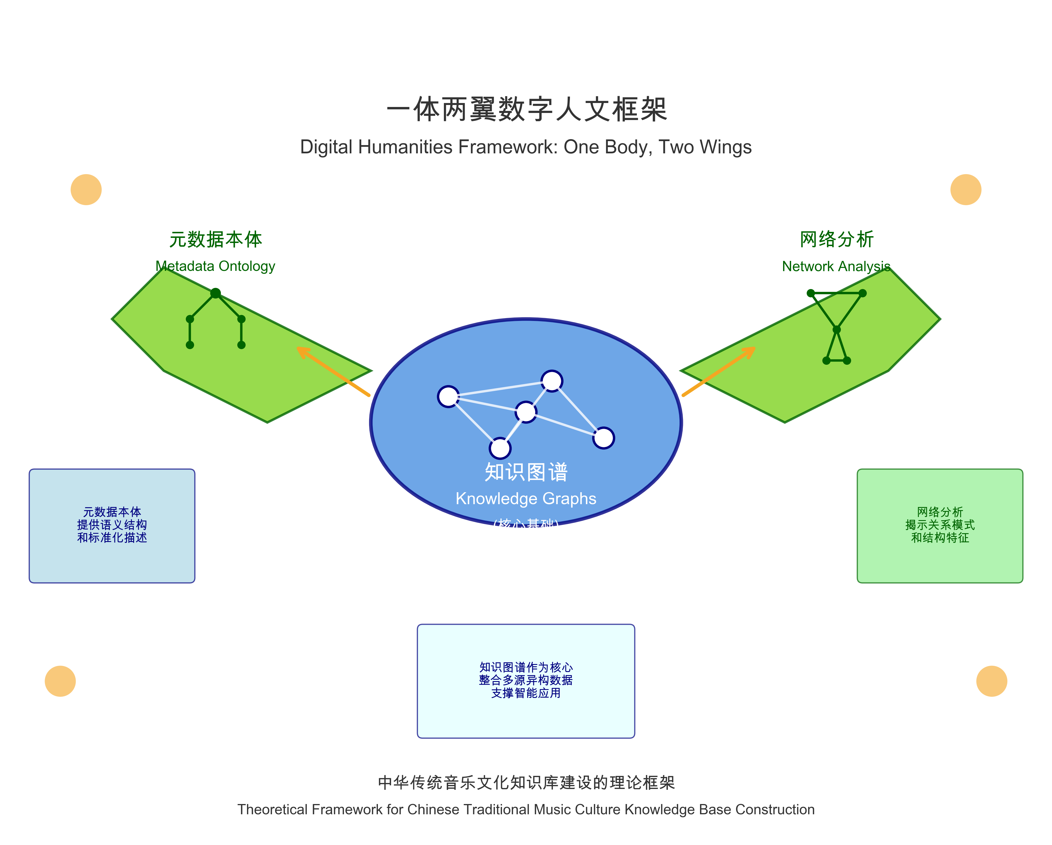
Metadata ontology provides semantic structure and standardized descriptions
Network analysis reveals relationship patterns and structural characteristics
Provides a foundation for the formalization of academic systems, disciplinary systems, and discourse systems

Slide 8
Semantic Organization of Metadata -> Ontology
(rendered in OWL--a special RDF language)
A graph database with ontology is a genuine knowledge graph. Definition:
Ontology reflects knowledge structure and knowledge organization method, involving nodes as instances of classes, and edges as shared semantic relationships or properties, such as hierarchical relations between parent and child classes. Ontology embodies the way of defining knowledge and classification methods...and even what kind of knowledge inference effects can be formed. An ontology serves as the foundational model of the semantic web and is also a descriptive language, such as those using RDF Schema and OWL formats. Metadata has shown a trend toward ontologization, so it is appropriate to collectively refer to them as "metadata ontology."

Slide 9
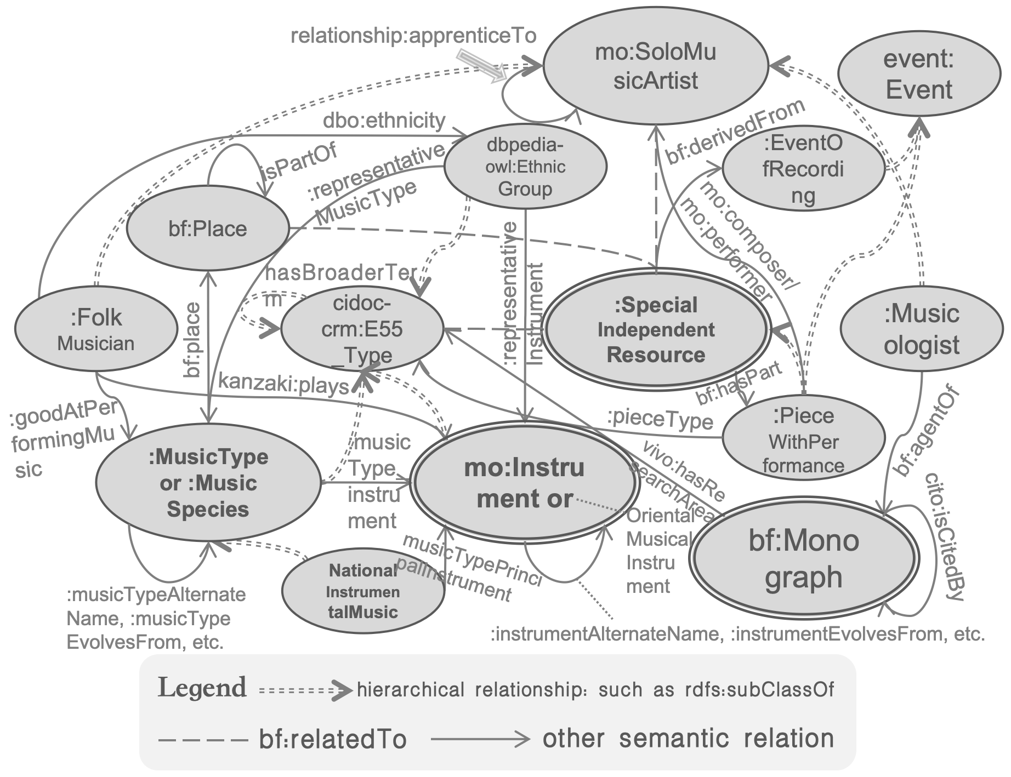
Semantic Organization of Metadata -> Ontology
[a “knowledgeBase” with ontology ->
superceeds a normal “dataBase”]
<- a more intuitive
& flexible approach of：
- organizing knowledge;
- displaying knowledge;
- retrieving knowledge.
Ontology: Chinese
TraditionalMusicCulture
Knowledge Base (CTM)
schematic diagram

Slide 10
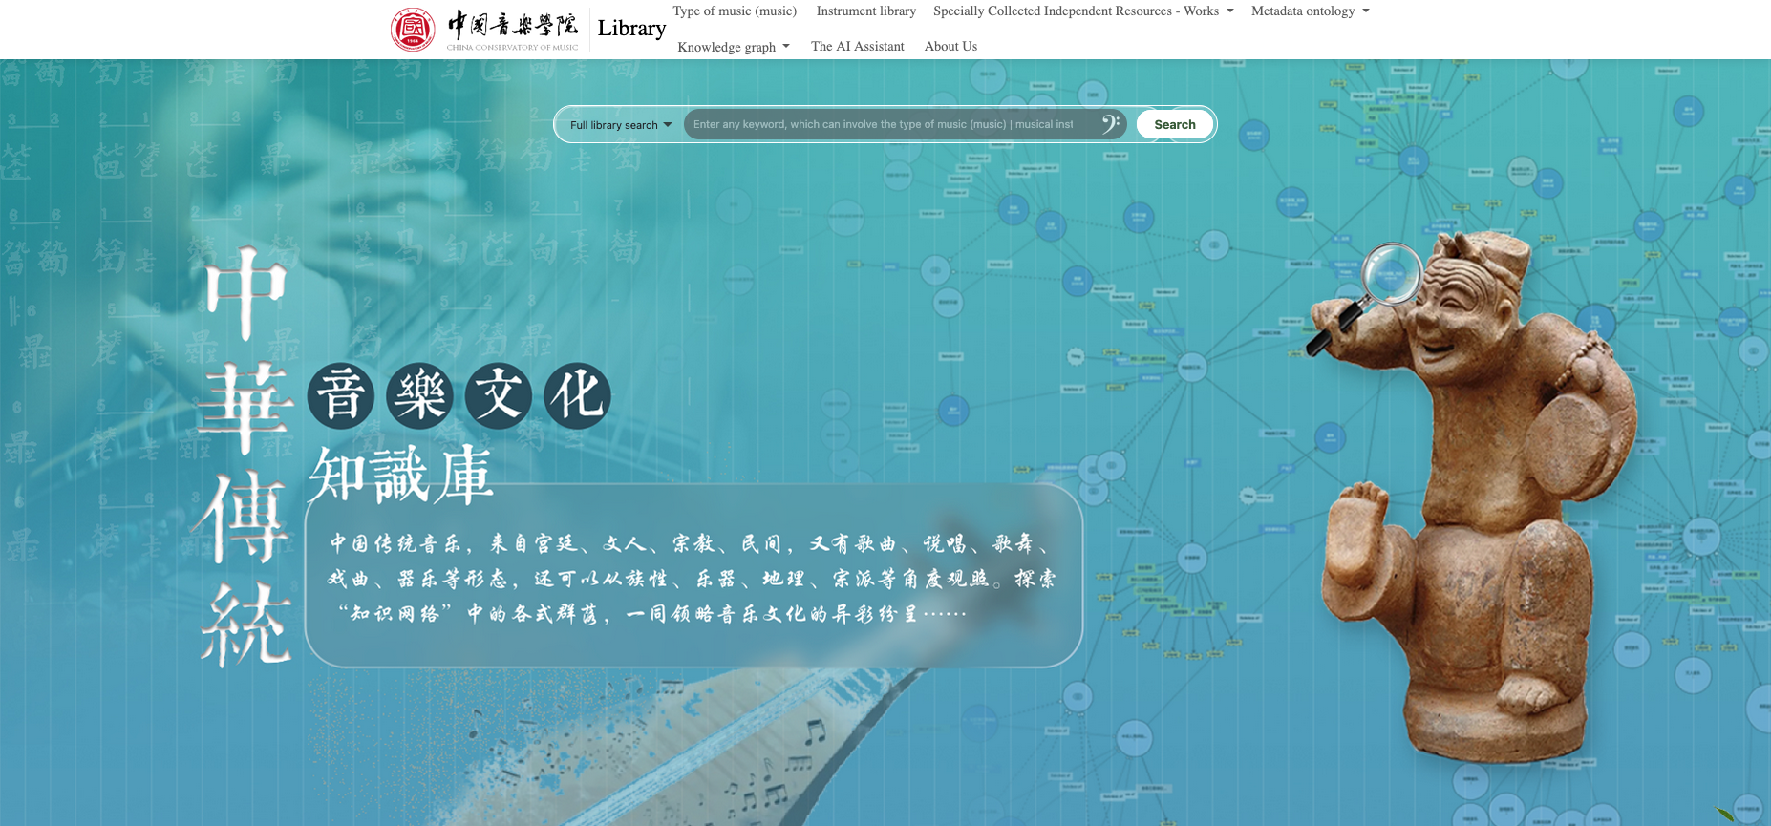
Single-box Search on the Main Page
the global/holistic ontology: background
translation: Chinese traditional music comes from the acient courts, literati circles, religeous groups and folk communities, manifesting in forms as songs, narrative rap (speech-song fusion), singing-dancing integration, instrumental music, which can also be observed from viewpoints as ethnicity, instrumentation, geography and factions。Let’s explore various communities within the “knowledge network”, reveling in their dazzling multiplicity.

Slide 11
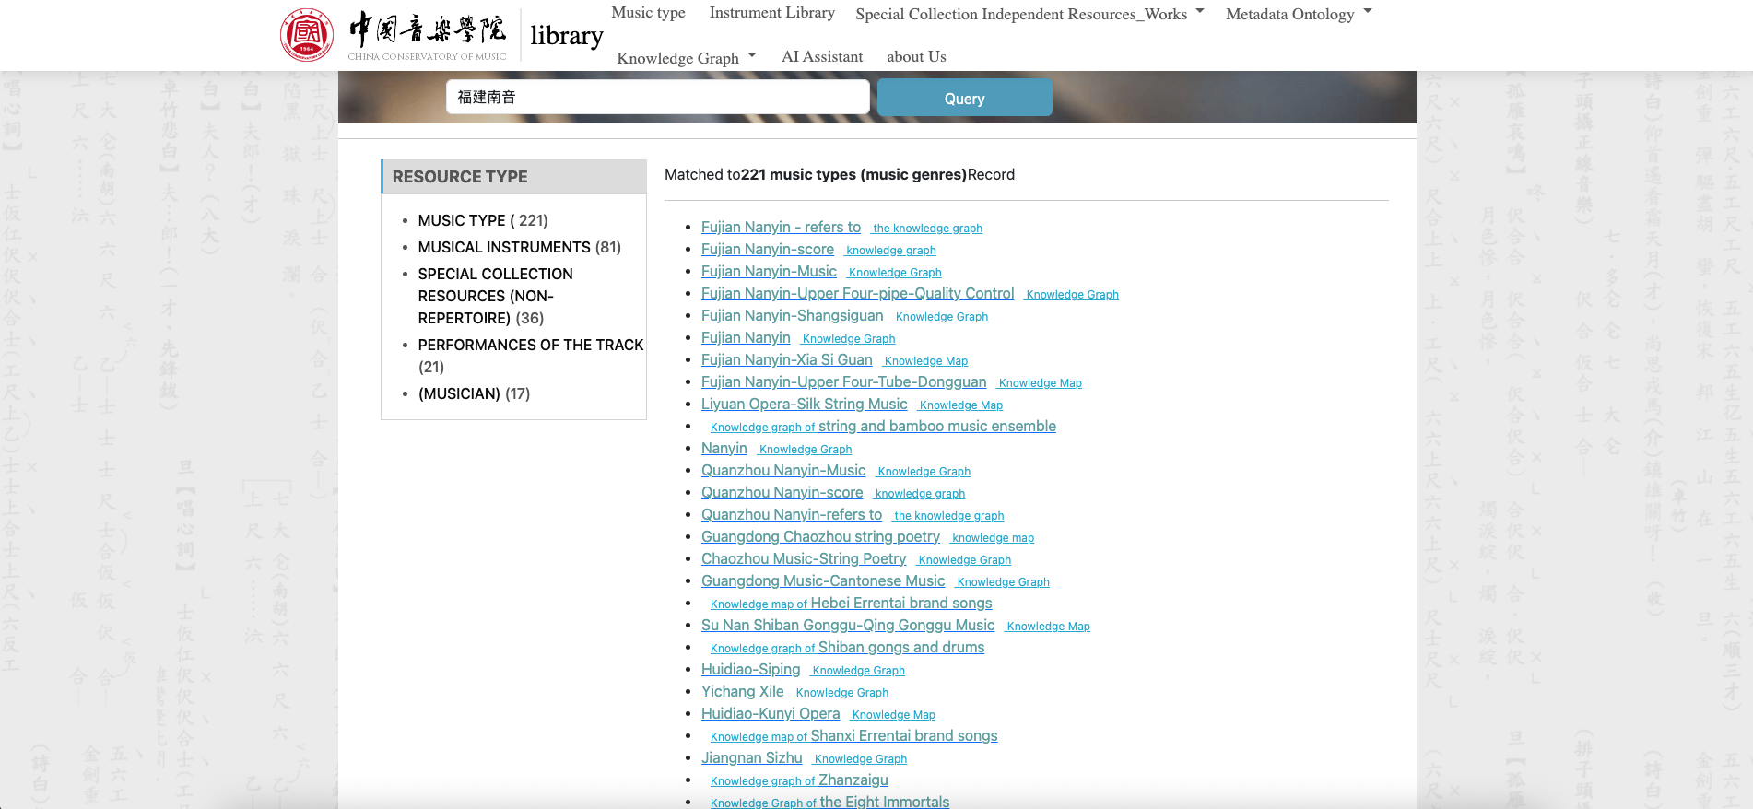
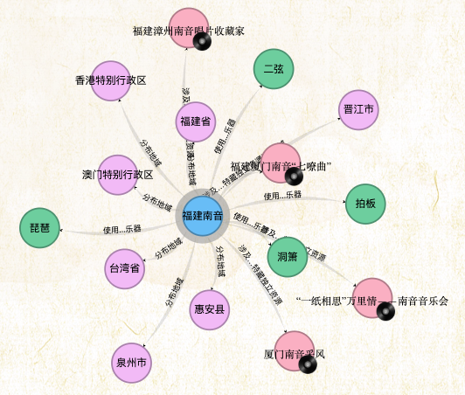
Single-box Search, e.g., after inputing “福建南音” （translation:Fujian Nanyin/South Sound ）
18号字（dark color 15）
This references China's ancient gongchepu notation system (工尺谱) – a traditional musical tablature using Chinese characters to represent pitch and rhythm.
knowledge graph:graph query
-> visualization
next page

Slide 12
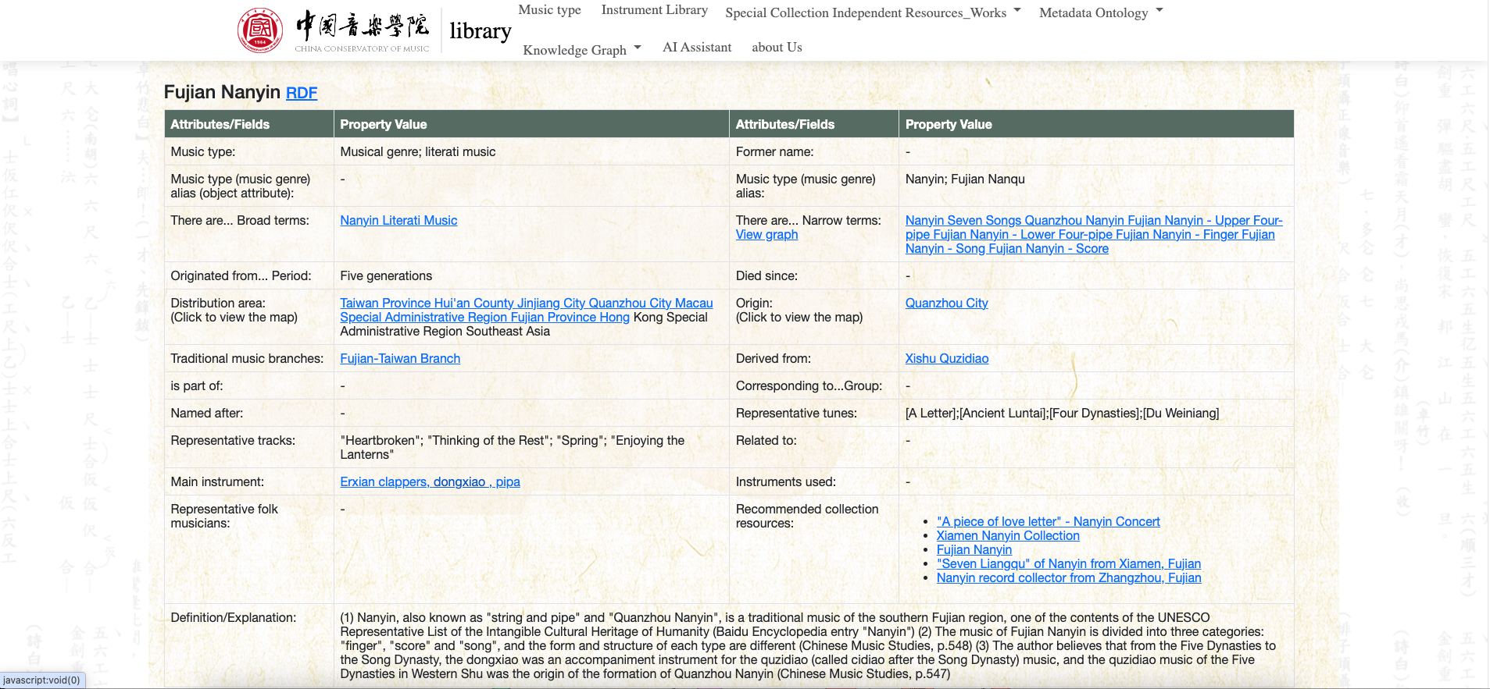
migrated to the “Linked Data Publishing Platform”; Each blued field links to other URI-linked nodes.

Slide 13
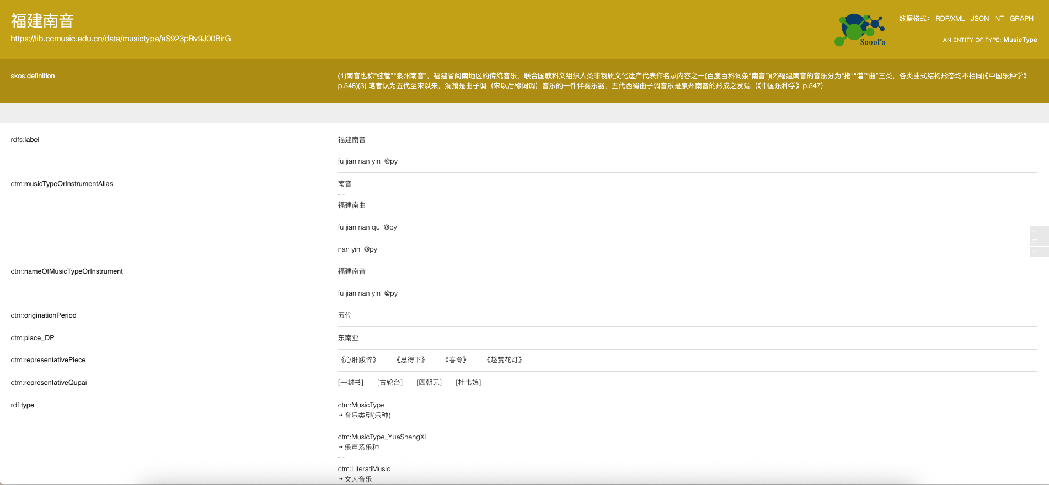
Linked Data Publishing Platform for Fujian Southern Sound
If we say the previous page resembles a Wikipedia display, this page mirrors the structured-data interface of linked knowledge bases like DBpedia or Wikidata.

Slide 14
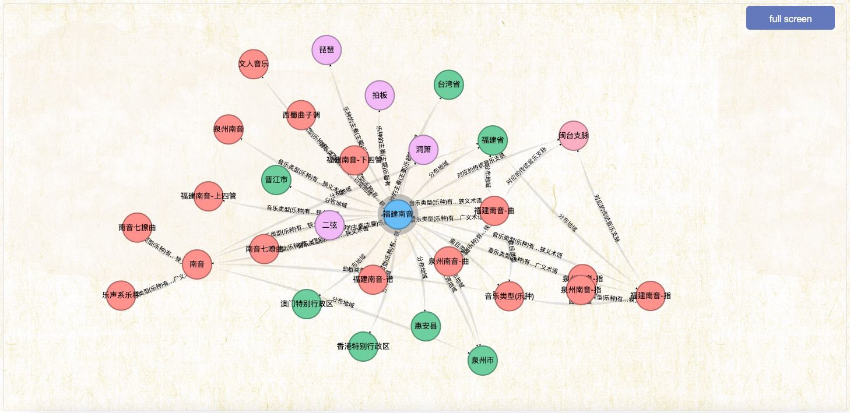
scroll down to see the egocentric network for “福建南音” （translation:Southern Music/Sound in Fujian Province）
--not only one-step ego network:
You can double-click nodes to expand the scope, traversing the knowledge network for exploration

Slide 15
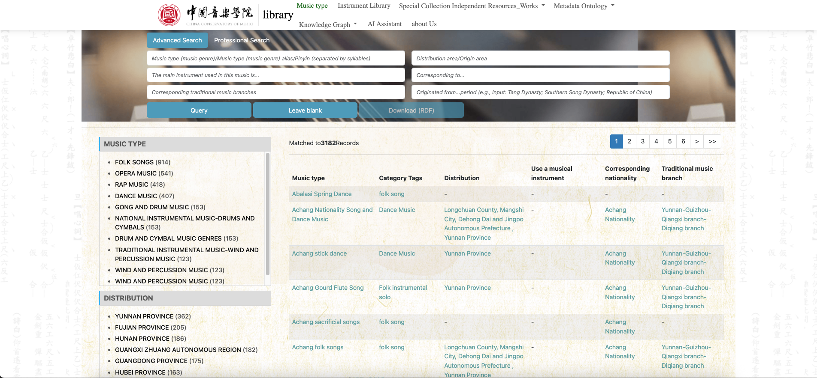
Can also enter the “Music type” tabular interface to retrieve Fujian South Sound. Advanced query interface with multiple filtering condition（intersection relationship）
(1) musicType
(2) instrument
(3) traditional music branches
(4) distribution
area
(5) ethnic
group
(6) originates from historical
period (dynasty)
data reusable
professional search syntax

Slide 16
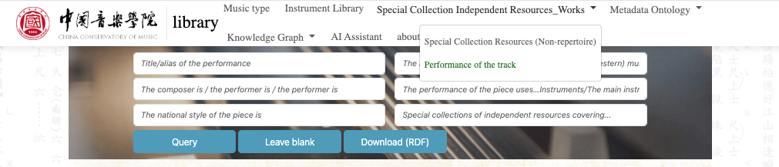
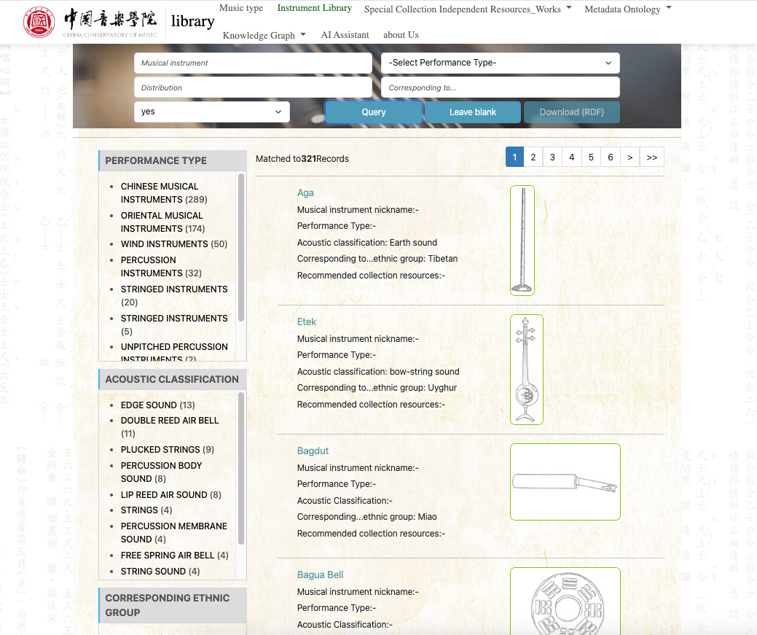
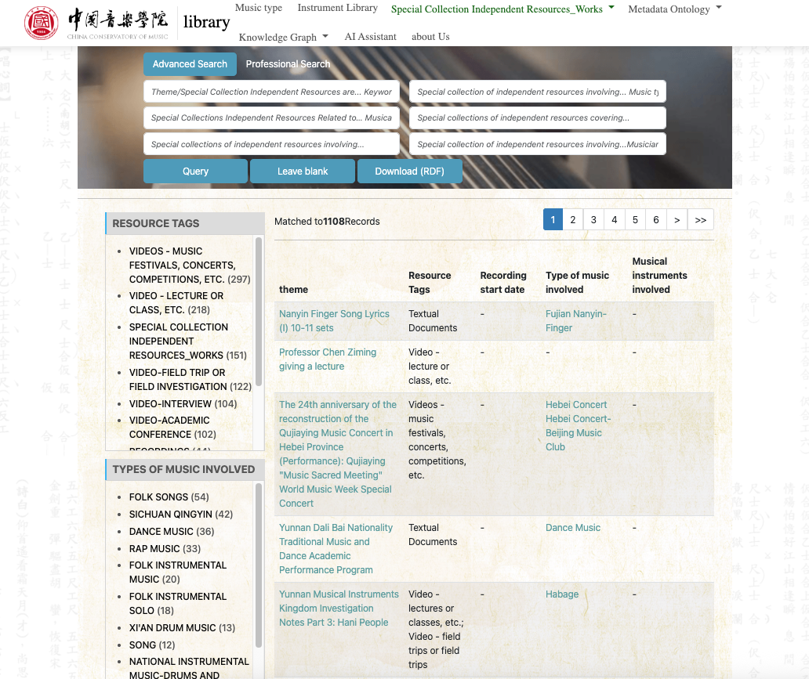
Special Collection Resources (bf:hasPart -PiecePerformance
Chinese or Eastern Music Instruments
Warehouse

Slide 17

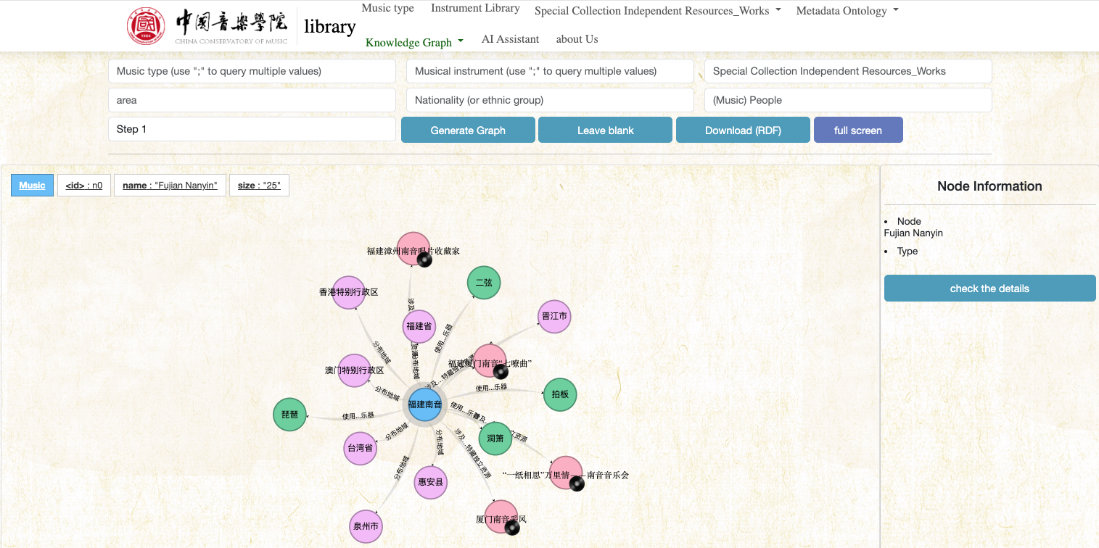
Graph Query 1: facilitate both union and intersection relationship
[1] Search results are derived from the backend server.
U
U
You can select multiple related keyword-nodes as starting points. By expanding their respective neighborhoods simultaneously, the visualization reveals topological community structures. E.g., the bridge part between 2 densely clustered communities may represent ....
to switch between 1-step or 2-step length ego network
E.g., input more than one music species. Then you can see their relation via observation on the community boundary connection with the intuitionistic density.
next page--
query condition:
MusicType:福建南音;西安鼓乐
Instrument:二胡;琵琶
area/place:江西省
U
These community "clouds" provide structural insights into how musical concepts are actually related within the domain, often revealing unexpected conceptual boundaries, overlapping traditions, or hidden connections that would not be apparent through linear search methods. This approach transforms vague research interests into concrete, visually-guided exploration paths through the knowledge space.

Slide 18
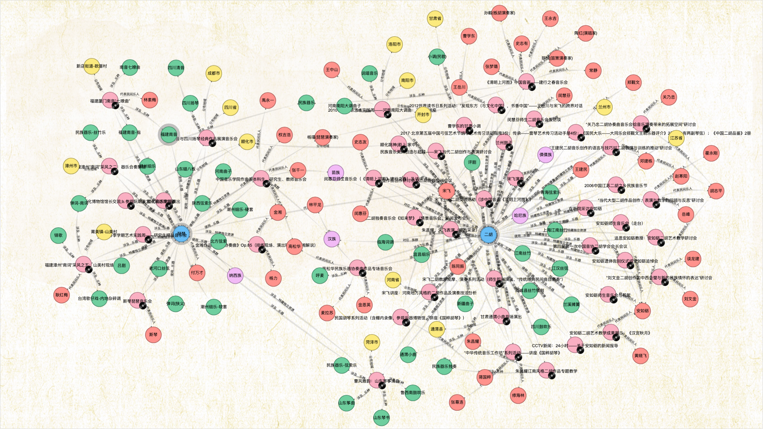
graph query based on union relationship
Click on the vinyl-icon nodes to access the “special collection resources”, which will contain playable recordings.

Slide 19
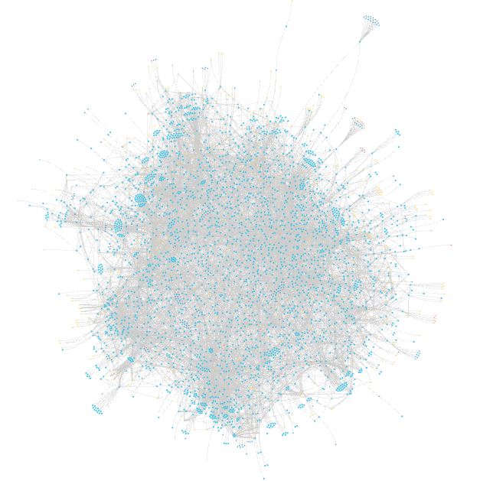
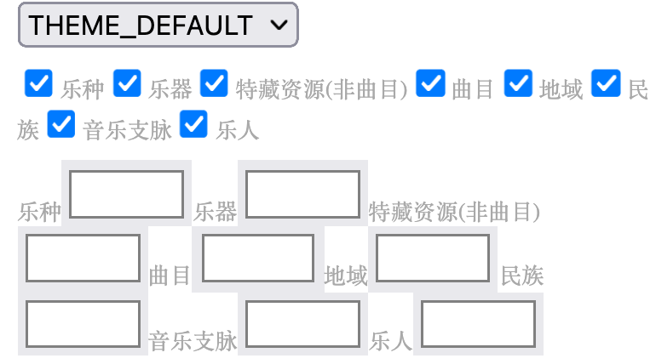
Graph Query 2:
[2] Search results are derived from data periodically uploaded by the music librarian.
node neighbourhood retrieval
panoramic visualization：
A->B path traversal
/ˌpænəˈræmɪk/
✅1.MusicSpecies;2.Instrument;3.SpecialIndependentResource(collection);4.PieceWithPerformance;5.Place;6.EthnicGroup;7.MusicBranch;8.MusicArtist

Slide 20
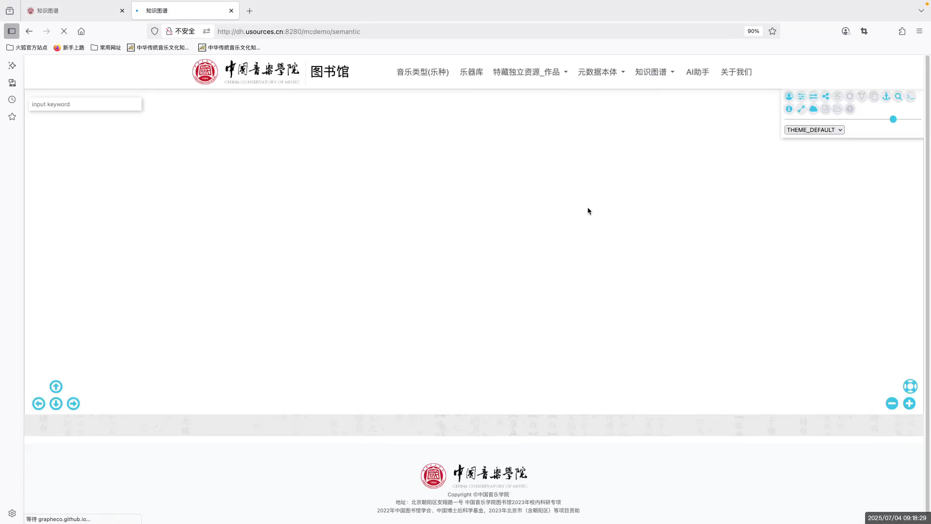
graph query 2:
node neighbourhood retrieval
panoramic visualization：
A->B path traversal
MusicSpecies;Instrument;SpecialIndependentResource(collection);PieceWithPerformance;Place;MusicBranch;MusicArtist

Slide 21
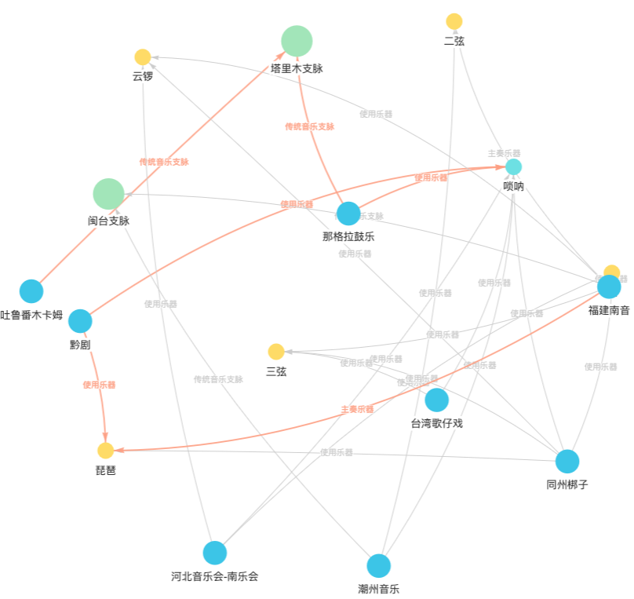
graph query 2: A->B path traversal
to explore the relationship with distance threshold
to explore the shortest path between 2 nodes:
e.g., What’s the potential relationship
between Turpan Muqam in northwest China and
Fujian South Sound in southeast China?
--------
TurpanMuqam-[traditionalMusicBranch]->(1)TarimMu
sicBranch<-[traditionalMusicBranch]-(2)NgalraDrumMusic-
[usesInstrument]->(3)surnay<-[usesInstrument]-(4)QianOpera-
[usesInstrument]->(5)pipa<-[hasPrincipalInstrument]-(6)Fujian
SouthSound
/
'tuə'pɑ:n, 'mukæm
/
You can explore relationships by adjusting the maximum depth (max-depth) parameter through iterative debugging. Start with a 1-step path length to search for relationships; if none are found, gradually increase the step length until connections are discovered. For example, in this knowledge base, by setting the step length to 6, we immediately discovered 10 different types of relationships.

Slide 22
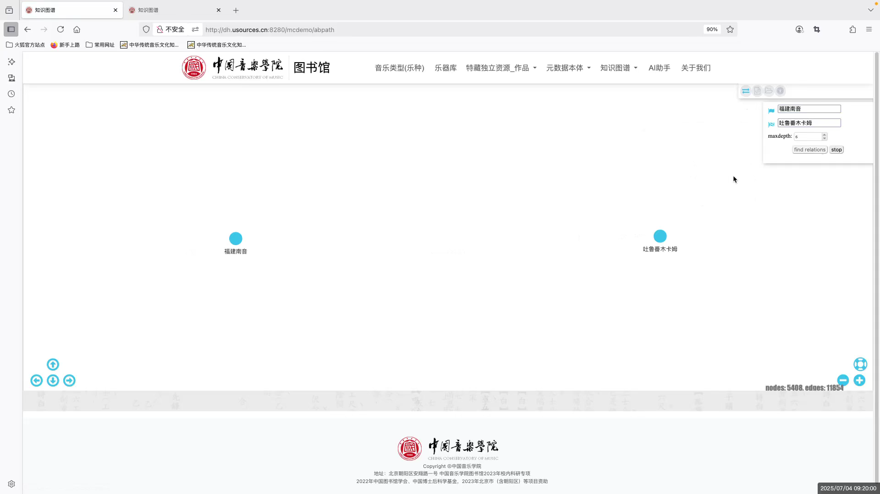

Slide 23
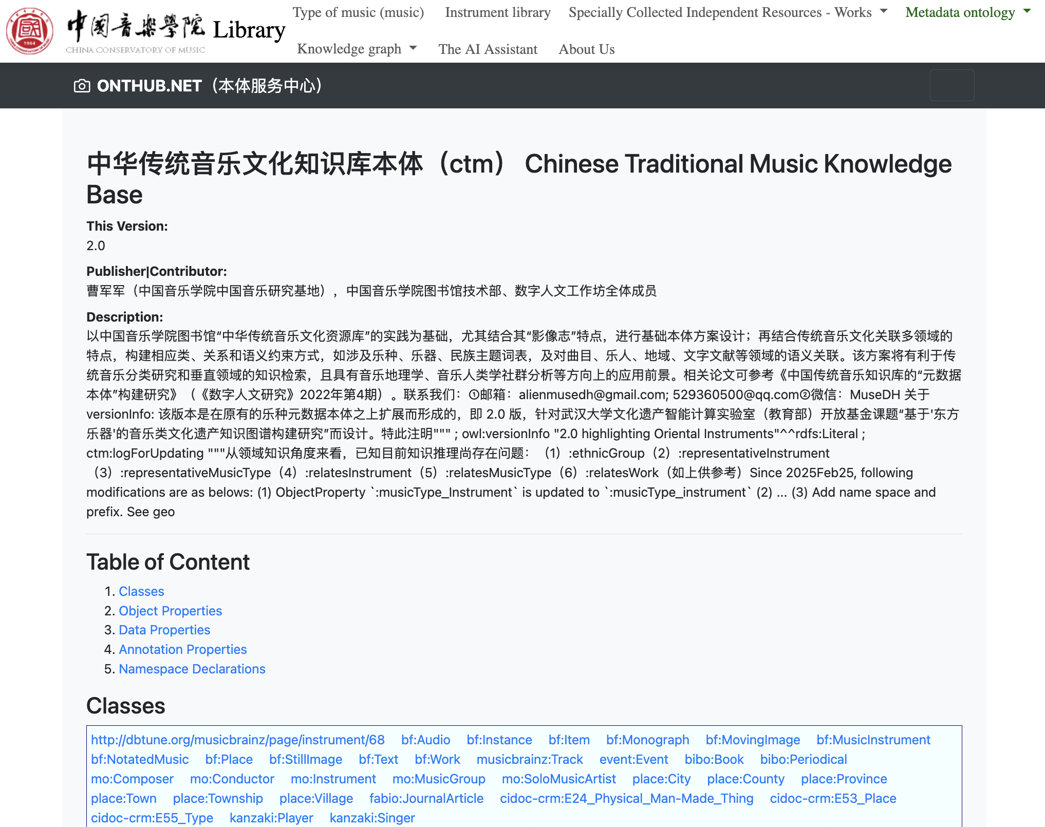
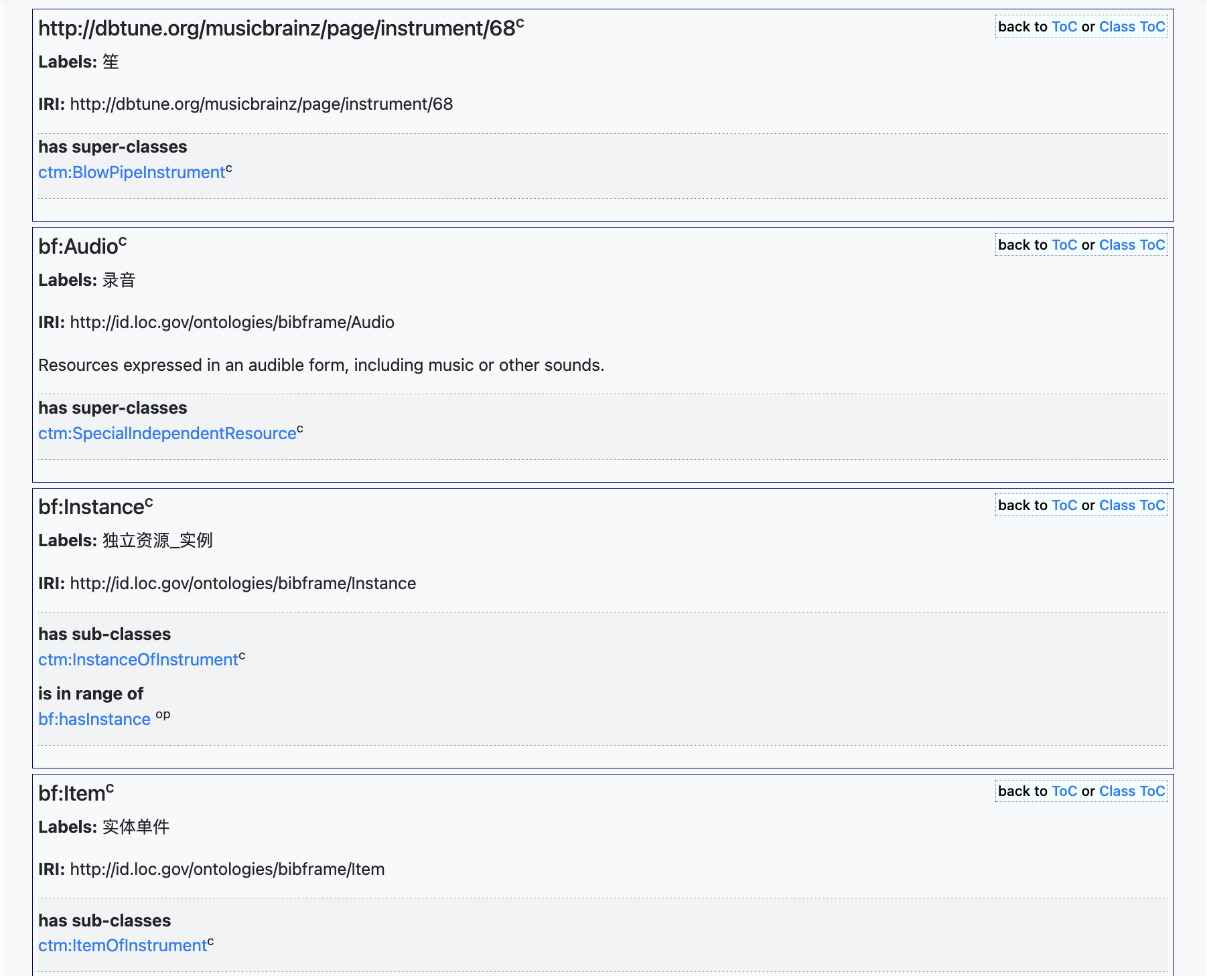
SPARQL query: refering to ontology list from the frontend
However, graph visualization retrieval is subject to the interface constraint. In order for more comprehen...
SPARQL - an RDF specific query language;
Structurize any NLQ (Natural Language Question) into SPARQL syntax prior to mapping with the schema (e.g.,ontology) the way knowledge was originally organized. Ontology elements:

Slide 24
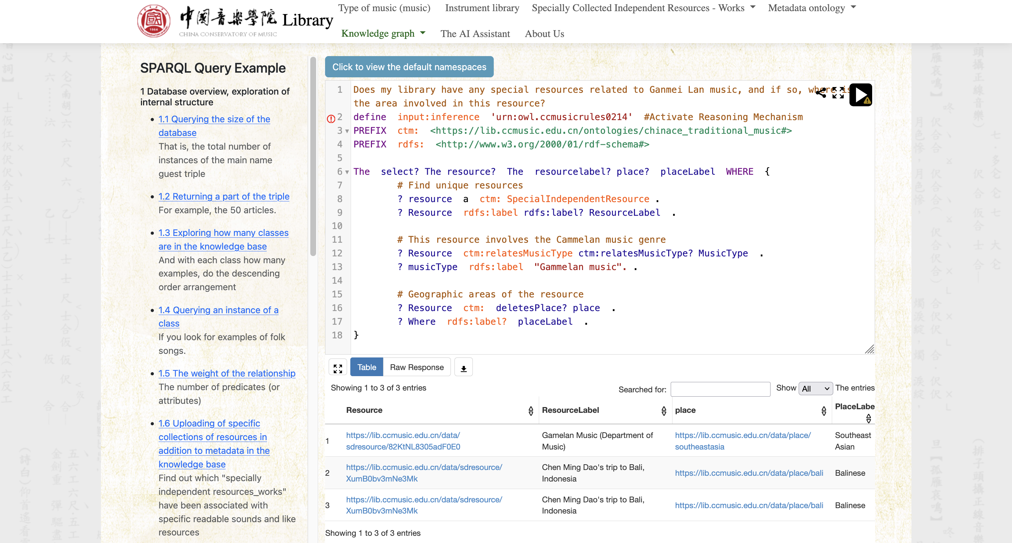
SPARQL query interface
Gamelan Music
nodes as URI are accessible to linked data publishing platform

Slide 25
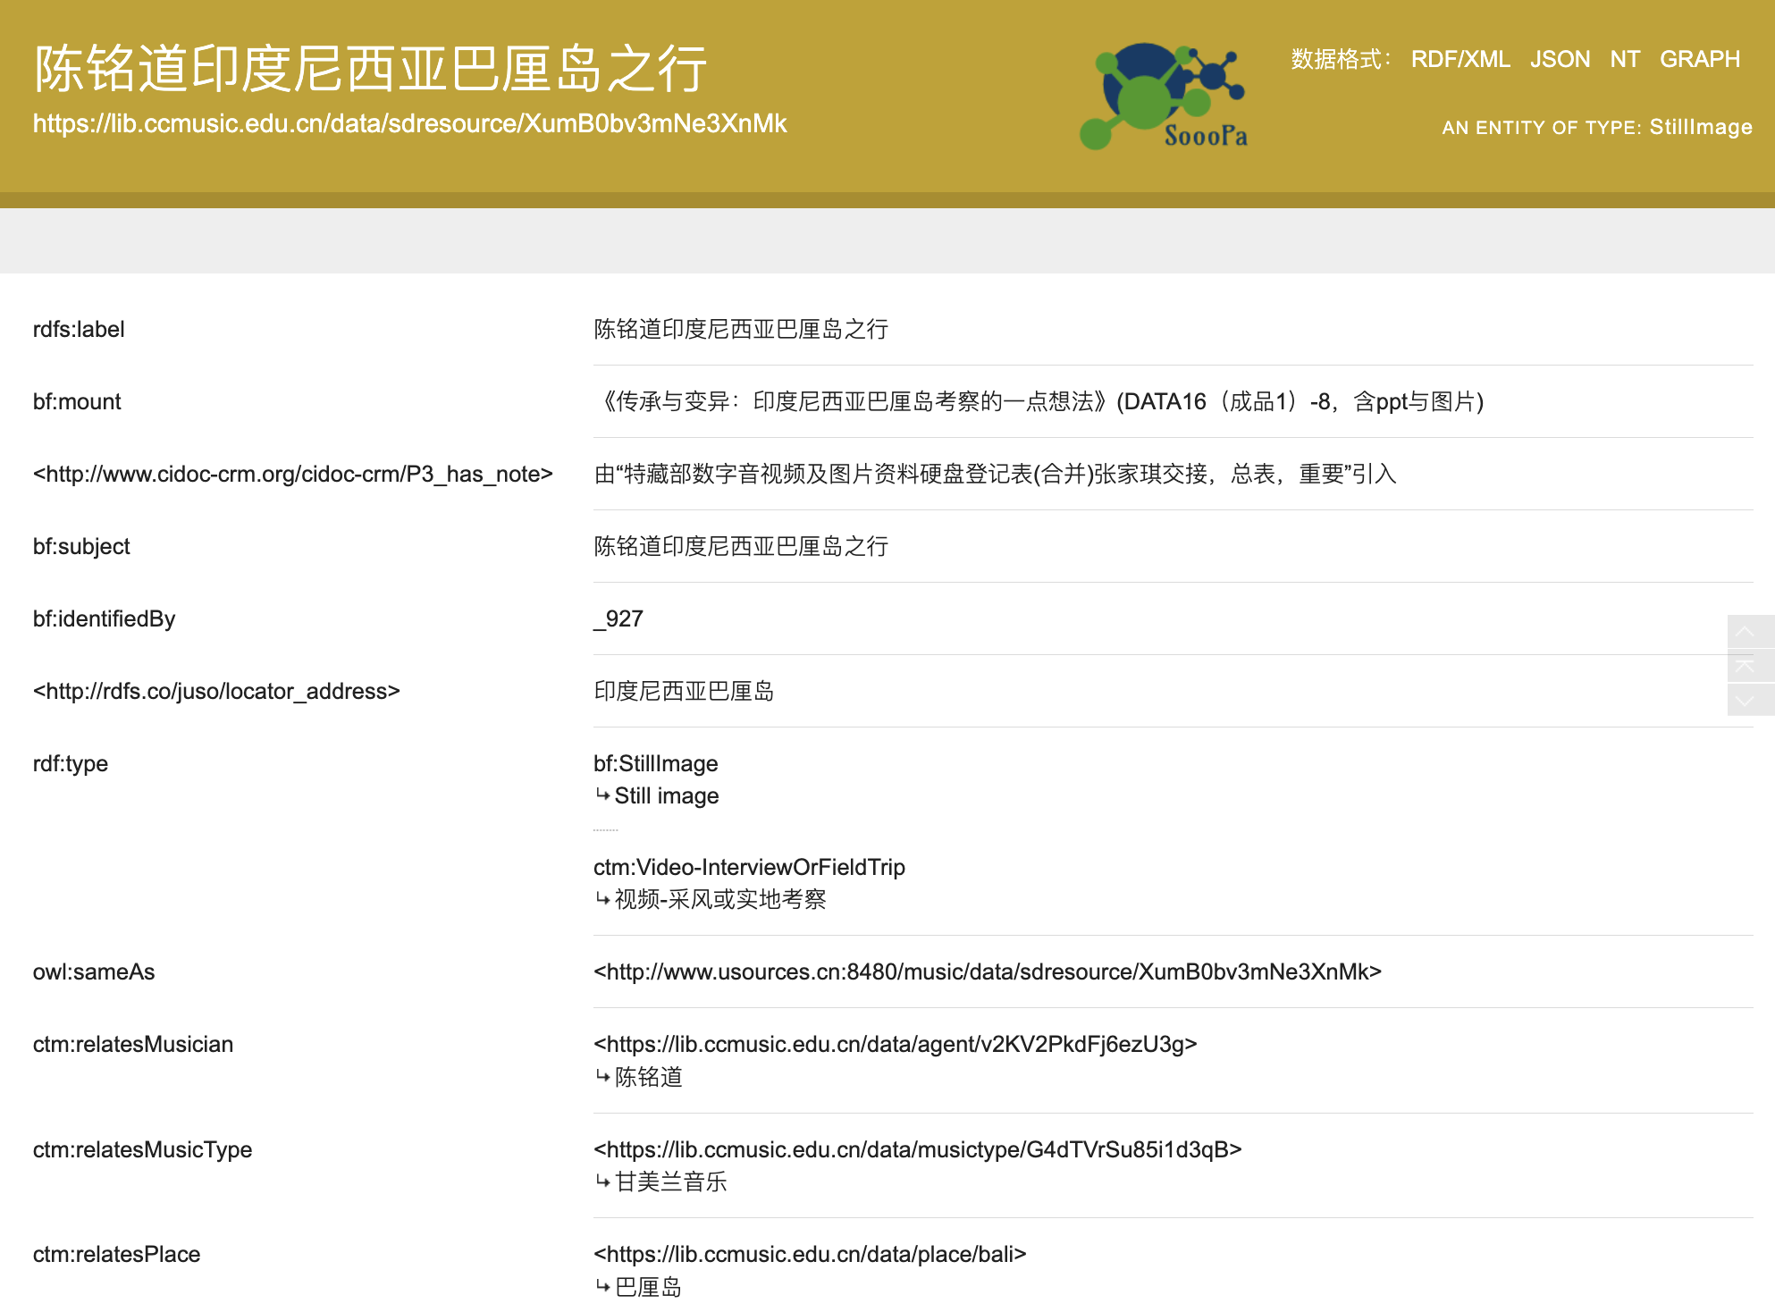
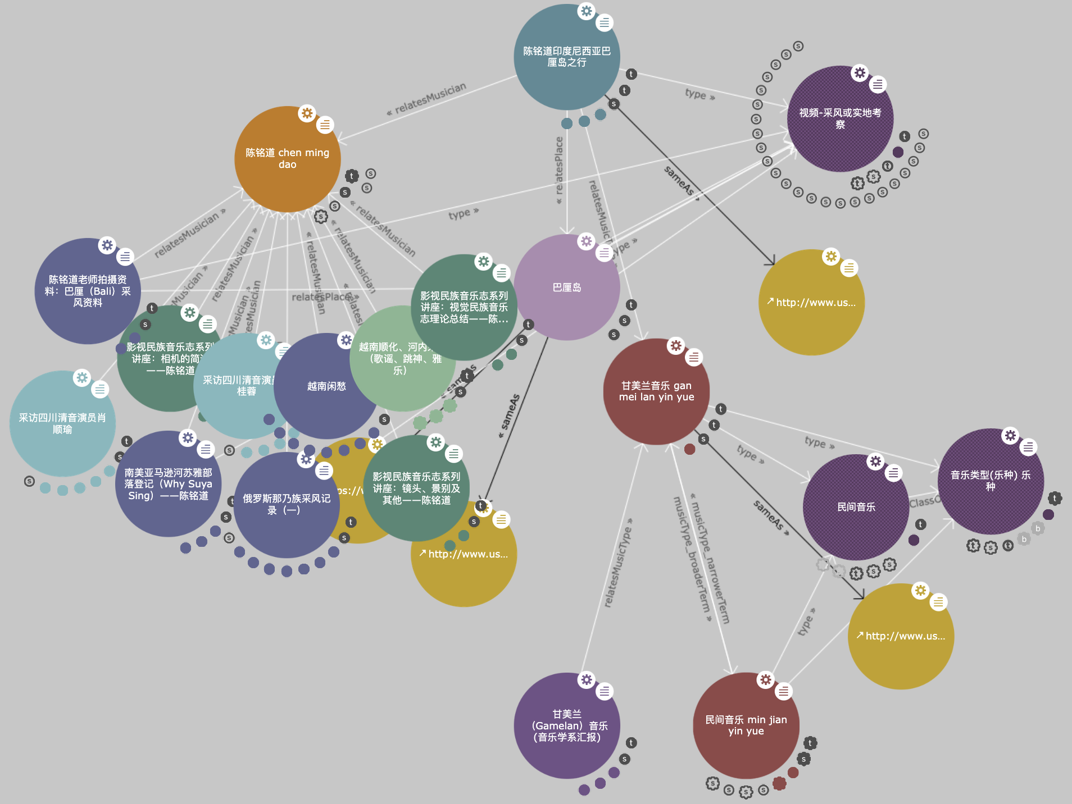
SPARQL query result-> linked data publishing platform
Chen Mingdao's Trip to Bali, Indonesia and related resources
properties values with labels:
properties inFormOf name SpacePrefix+FragmentID...

Slide 26
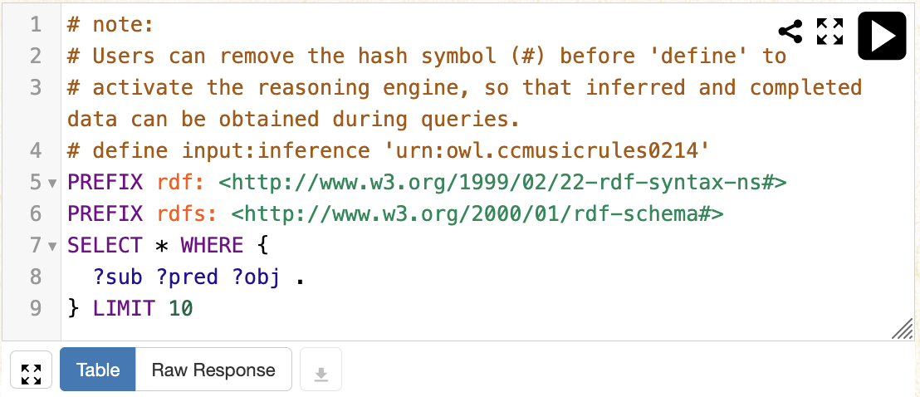
SPARQL query based on knowledge reasoning/inference
Ontology is not only just reference for SPARQL writing, but also for supplementing data with reasoning.
ontology-based reasoning activation
retrieved data can be downloaded as RDF
e.g., Find the national instrumental music.

Slide 27
SPARQL query based on knowledge reasoning/inference
ontology-based reasoning activation
e.g., Find the national instrumental music
define input:inference 'urn:owl.ccmusicrules0214'
PREFIX ctm: <https://lib.ccmusic.edu.cn/ontologies/chinese_traditional_music#>
PREFIX rdf: <http://www.w3.org/1999/02/22-rdf-syntax-ns#>
PREFIX rdfs: <http://www.w3.org/2000/01/rdf-schema#>
SELECT * WHERE {
?MusicSpecies a ctm:NationalInstrumentalMusic;
rdfs:label ?label }
without supplementation from reasoning: 132 entries -> 1290 entries
Through the activation of reasoning capabilities, resources belonging to child-classes of NationalInstrumentalMusic are automatically retrieved. This effectively addresses the inherent limitations of conventional flat cataloging and classification methodologies.

Slide 28
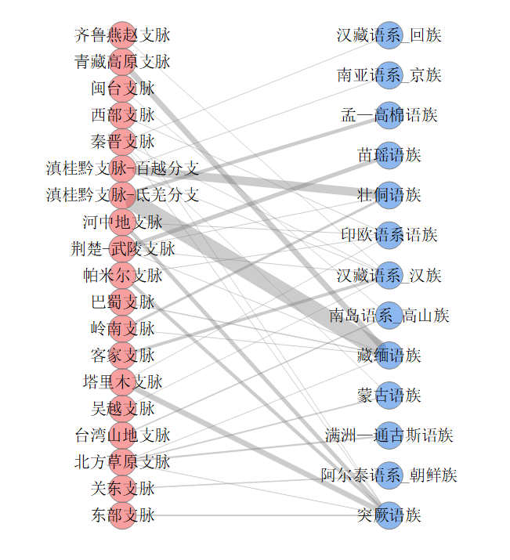
Digital Humanities Application:correspondence between geo music branches and language
branches / language families
Qilu-Yanzhao Branch
Bipartite Graph
Sino-TibetanLanguageFamily(HuiPeople)
/baɪˈpɑːrtaɪt/
Qinghai-Tibet Plateau Branch
Austroasiatic Language Family (Jing People)
Min-Taiwan Branch
Western Branch
Mon-Khmer Branch
Qin-Jin Branch
Hmong-Mien Branch
Yunnan-Guangxi-Guizhou Branch (Baiyue Sub-branch)
Yunnan-Guangxi-Guizhou Branch (Di-Qiang Sub-branch)
Zhuang-Dong (Tai-Kadai) Branch
Hezhongdi Branch
Indo-European Branch
Jingchu-Wuling Branch
Chinese Music Map
based on
Chinese traditional
music branches
Pamir Branch
Sino-Tibetan Language Family (Han Chinese)
Bashu Branch
AustronesianLanguageFamily
(TaiwaneseIndigenousPeoples)
Lingnan Branch
Hakka Branch
Tibeto-Burman Branch
Tarim Branch
Mongolic Branch
Wu-Yue Branch
Taiwan Mountain Branch
Manchu-Tungusic Branch
Northern Grassland Branch
Altaic Language Family (Korean People)
Guandong Branch
Eastern Branch
Turkic Branch

Slide 29
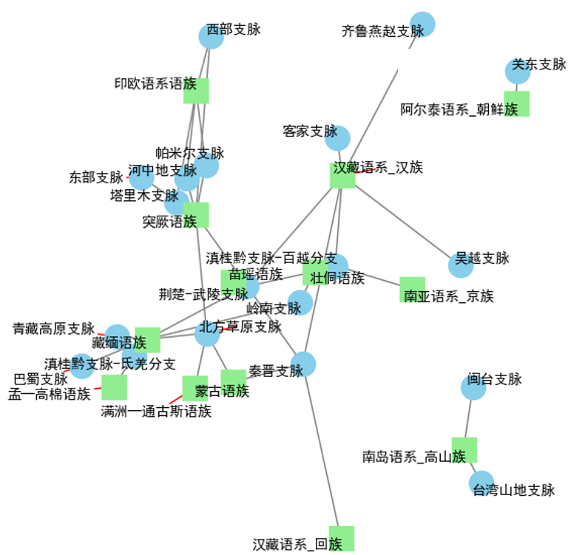
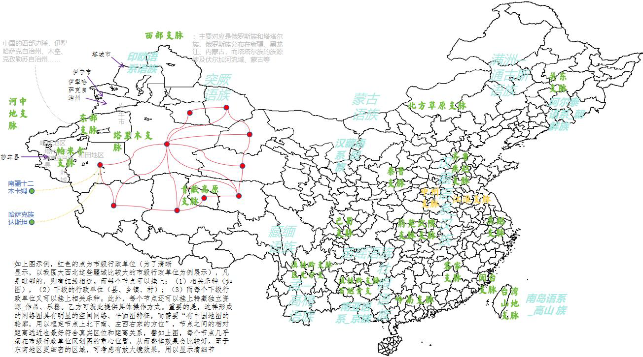
Digital Humanities Application
Qilu-Yanzhao Branch
Western Branch
Indo-European Branch
Chinese music map based on
Traditional music branches
Yunnan-Guangxi-Guizhou Branch (Baiyue Sub-branch)
Hakka Branch
Altaic Language Family (Korean People)
Pamir Branch
Eastern Branch
Hezhongdi Branch
Tarim Branch
Sino-Tibetan Language Family (Han Chinese)
Turkic Branch
Wu-Yue Branch
Hmong-Mien Branch
Jingchu-Wuling Branch
Zhuang-Dong (Tai-Kadai) Branch
Qinghai-Tibet Plateau Branch
Lingnan Branch
Austroasiatic Language
Family (Jing People)
Tibeto-Burman Branch
Northern Grassland Branch
Qin-Jin Branch
Mon-Khmer Branch
Min-Taiwan Branch
Manchu-Tungusic Branch
AustronesianLanguageFamily
(TaiwaneseIndigenousPeoples)
Mongolic Branch
Yunnan-Guangxi-Guizhou Branch (Di-Qiang Sub-branch)
Sino-TibetanLanguageFamily(HuiPeople)
The distance between the 2 types of nodes reflect the correlation strength, and the overall layout along with relative positions echos the geographical location of the object on Chinese map.

Slide 30
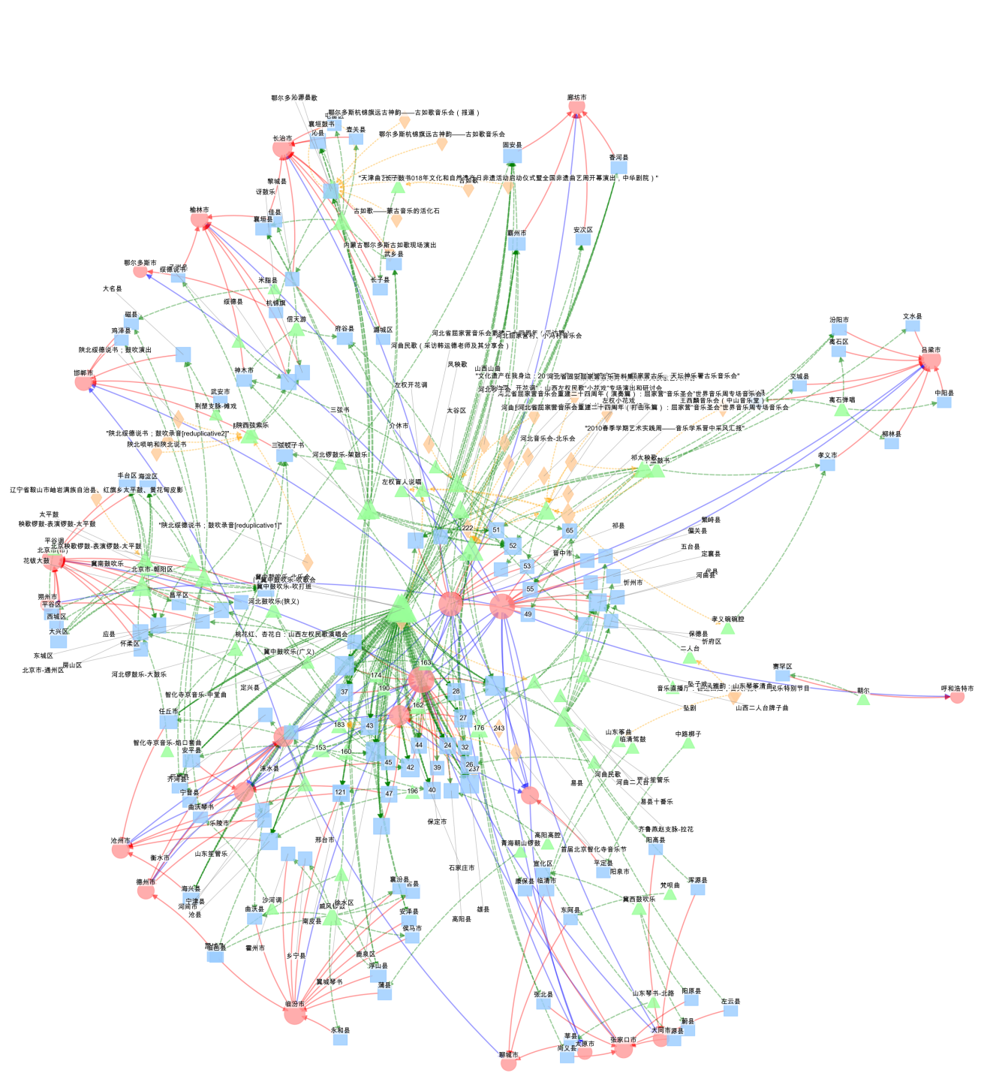
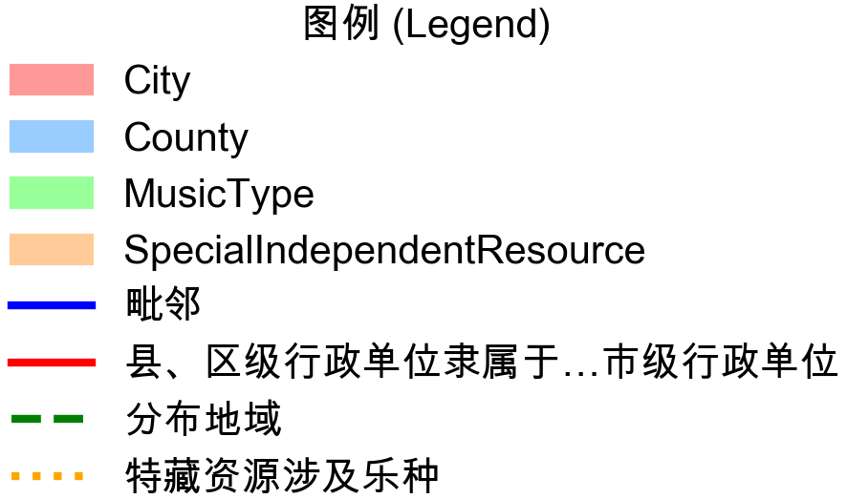
Digital Humanities Application: geographical music research
1.retrieval based on geographical neighbouring relation
What musical genres exist in other cities within a 2-step range adjacent to Shijiazhuang City, Hebei Province, and their subordinate administrative units at all levels? Regarding these musical genres, does our library/museum have any special collections or resources?
We can use SPARQL to obtain
heterogeneous network data（in typed edge list format）
To care for evenly distributed node display (avoiding crowding) while preserving their geographical relative positions,we use the city nodes and their neighbouring relations to construct the network framework

Slide 31
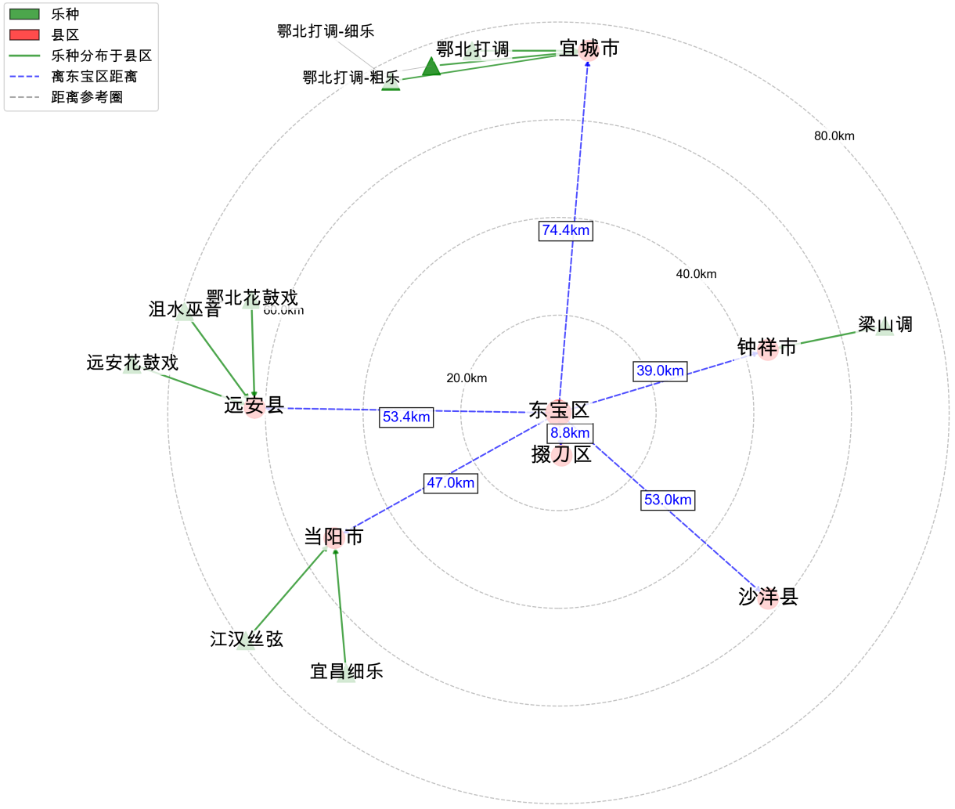
Digital Humanities Application: geographical music research
2.retrieval based on geographical coordinates
·What music genres exist within a 75-kilometer radius of Jingmen City (Dongbao District), Hubei Province, and among these, which ones are in our library's collection?
--SPARQL results -> LLMs -> python scripts for visualization:
·The distances and positions precisely correspond to the real map.
·Answer:
There are 3 items related: 'Hubei Xianghe Daozhuizi Series Part One: Hubei "Xianghe Daozhuizi" Performance', 'Hubei Xianghe Daozhuizi Series Part Two: "Xianghe Daozhuizi" as a Regional School and Its Formation (Yao Yijun)', and 'Hubei Xianghe Daozhuizi Series Part Three: "Xianghe Daozhuizi" Lecture'.
(short for Large Language Models)

Slide 32
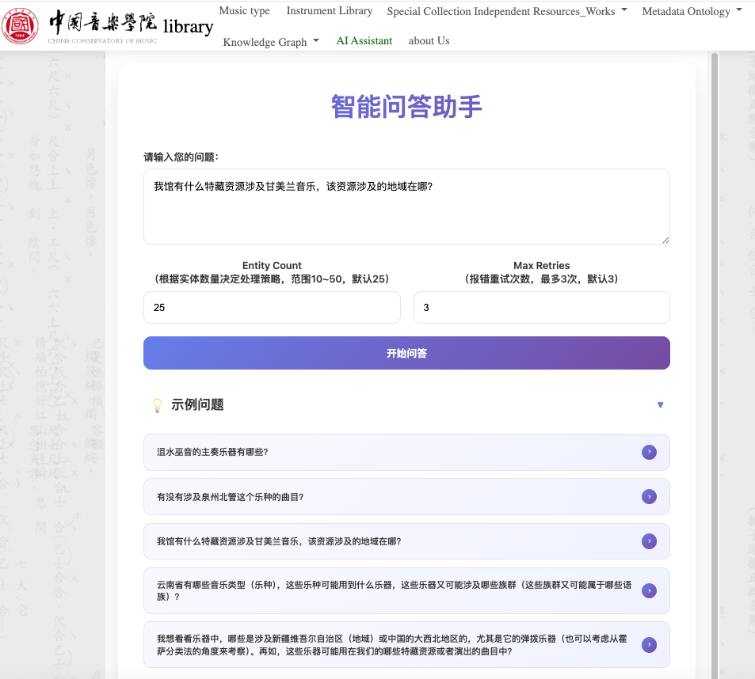
Question:Should music librarians master SPARQL before conducting complicated retrieval？
up to now
--Not Necessarily！
·LLMs to convert users’
Natural Language Question (NLQ) to
SPARQL with “prompt engineering”
·Context: ontology snippet (serving
as the schema) that
reflects the structure of the NLQ
·Issue: How to find a corresponding
ontology snippet for varied questions?
If we provide the whole, LLMs may
not concentrate...
intelligent Question
-answering Assitant
prevalence
questions for instance
brings up
straightforward line of thought

Slide 33
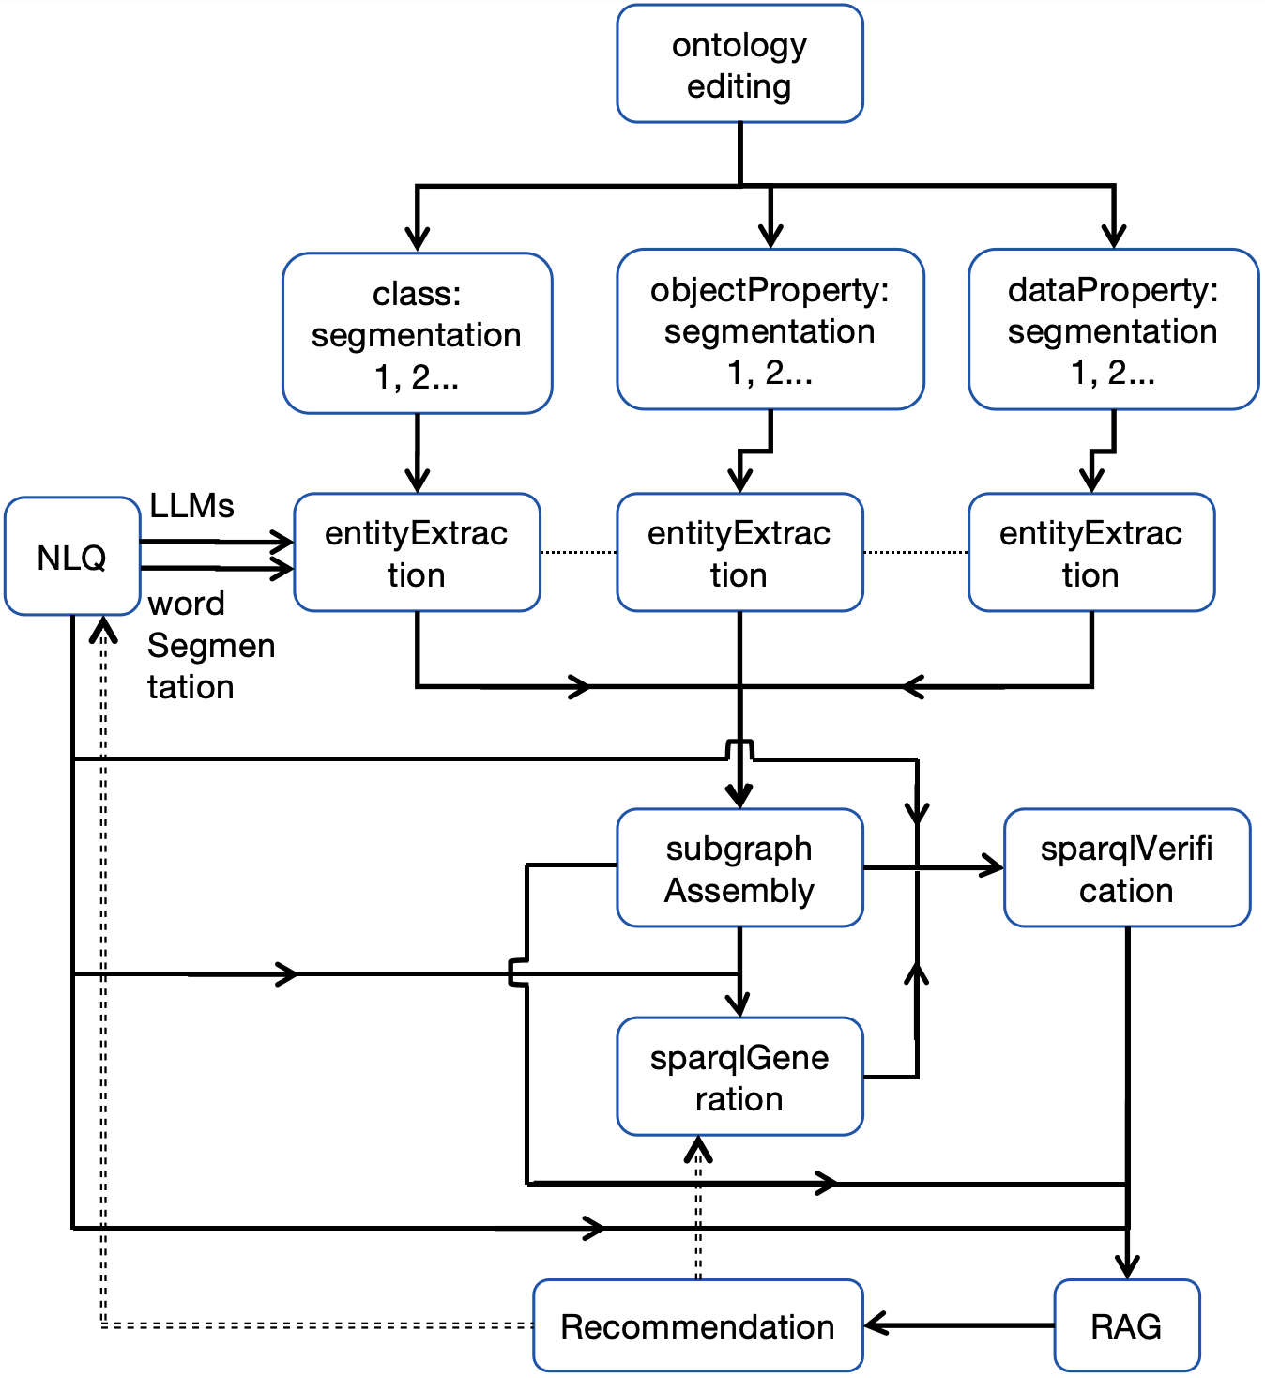

Digital Humanities Application: Intelligent Question -answering System
my paper: ESEA (East-and-Southeast-Asian) Traditional Music and Its Ontology-Subgraph-Driven NLQ2SPARQL Intelligent Question-Answering System Research （to be published on Cataloging and Classification Quarterly）
Workflow:
1. Specific Ontology Editing
--Protege
(1) Clarification and Enrichment of ...
(2) Semantic reinforcement. Eg:inverse
use ontology to replace shapes
(3) Simplification

Slide 34
Intelligent Question-answering System Workflow
2. Ontology Segmentation：into 3 parts
3. Entity Extraction from the Ontology Segments
LLMs are prompted to extract (isolated) entities from an NLQ by mapping them with all segments of the ontology. Hereby, the “entities” also include class, property, or instance.
--key point！It decides whether this approach is robust enough
4. (Ontology) Subgraph Re-Assembly
Ontology is also a special graph! The nodes represent classes,
Ambiguity of NLQ->extract more entities than actually need->basis for recommendation

Slide 35
intelligent Question-answering System Workflow
mainbody
5. SPARQL Generation and Verification Based on Subgraph
(1)claude 4 (2) reflection: ontology for validation instead of shapes
6. Retrieval Augmented Generation(RAG)
Illustration on the retrieval result...
-> A combination of LLMs' general knowledge and Knowledge Graph's domain-specific knowledge
2 scenarios of the rusults:
(1) If the result is too large or complicated (2) If the result is too small or even empty:
broaden the retrieval scope by relaxing query conditions/constraints in the SPARQL query, and other possible query patterns can be recommended
7. Recommendation System: based on the neighborhood in the ontology subgraph

Slide 36
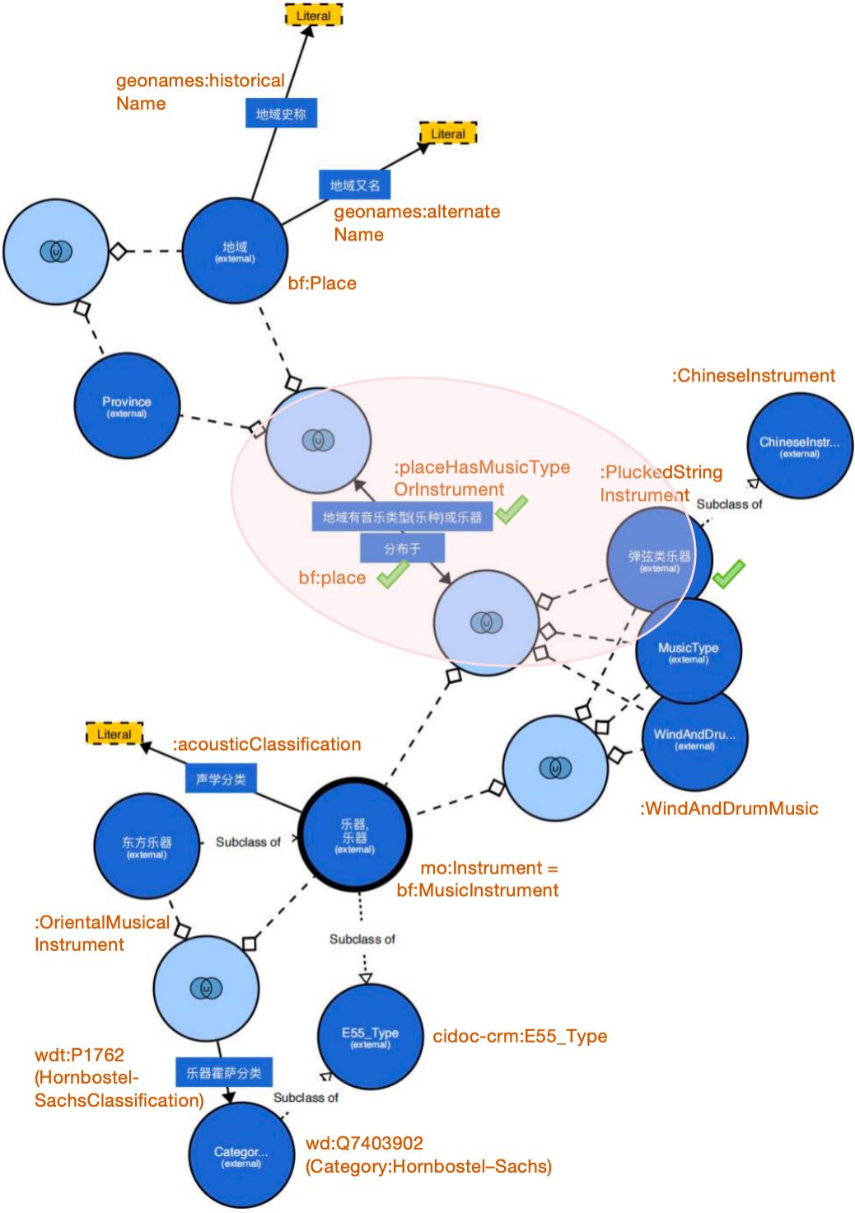
The Ontology Subgraph with Its Neighbourhood for the NLQ:
/ˈdɒbrəʊ/
Where is the "dongbula" (dobro/dombra, 东不拉) distributed, and what other plucked string instruments are distributed in the same regions/places? -> Light Red Area
define input:inference 'urn:owl.ccmusicrules0214' PREFIX bf: <http://id.loc.gov/ontologies/bibframe/> PREFIX ctm: <https://lib.ccmusic.edu.cn/ontologies/chinese_traditional_music#> PREFIX rdfs: <http://www.w3.org/2000/01/rdf-schema#>
SELECT ?place ?placeLabel ?otherInstrument ?otherInstrumentLabel WHERE { ?dongbula rdfs:label "东不拉" ; a ctm:PluckedStringInstrument .
?dongbula bf:place ?place . ?place rdfs:label ?placeLabel ; ctm:placeHasMusicTypeOrInstrument ?otherInstrument . ?otherInstrument a ctm:PluckedStringInstrument ; rdfs:label ?otherInstrumentLabel .
FILTER(?otherInstrument != ?dongbula) }
Reflection：
(1) The Ambiguity of NLQ necessiates recommendation
(2) Limitation of the approach: SPO-triples-question
By the way, I'd like to add something.
Notes:
prioritizes comprehensiveness than precision
Use LLMs to inversely create new NLQs along with SPARQL

Slide 37
intelligent question-answering system workflow
The recommended pairs of NLQ & SPARQLs are based on the neighbourhood of the subgraph
ontology neighbourhood + other SPARQL => other NLQs (e.g.):
(1) What acoustic classification does the Dobro belong to, and what other instruments are in the same acoustic classification?
(2) In the regions where Dongbula is distributed, besides plucked string instruments, what other types of instruments are there?
(3) What music types or genres are found in the regions where Dongbula is distributed?
knowledge reasoning
knowledge Question-Answering
knowledge recommendation
inversely
=>
a robust system with nearly 100% recall rate and 80% precision

Slide 38
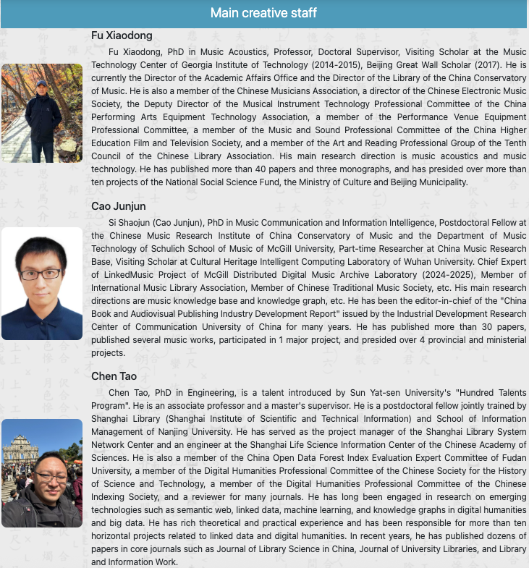
The project has received strong support from the Technical Department of the Library of the China Conservatory of Music and teachers and students of the Digital Humanities Workshop; it has also received attention and professional support from a series of experts and scholars in the field of traditional music in China. The works of some experts and scholars are important sources of metadata cataloging information for this project: such as Du Yaxiong (Overview of Folk Music of Ethnic Minorities in China), Wang Yaohua (Introduction to Traditional Chinese Music, 2020 edition), Ying Youqin (Dictionary of Chinese Musical Instruments), Yuan Jingfang (Introduction to Chinese Musical Species, 2021 edition), Lu Yingkun, Zhao Xiaonan, Wu Xiaoping, Jing Entao, Huang Siqi, Wan Xiaodong, etc. The project database construction has received foreign support from Professor Wang Xiaoguang, Director of the Cultural Heritage Intelligent Computing Laboratory of Wuhan University, Professor Ichiro Fujinaga of the Schulich School of Music of McGill University, Professor Jia Junzhi of the School of Information Resources and Resource Management of Renmin University of China, Professor Ou Shiyan of the School of Information Management of Nanjing University, and Mr. Zhu Houquan, General Manager of Beijing Yuanyin Technology Co., Ltd. Special thanks!

Slide 39


questions and interaction
I would greatly appreciate it if you could talk slowly and clearly with me.
For the consecutive information about linked data/semantic web technologies application in music database, please refer to the session of Wednesday (tomorrow)：
Session:Databases for Music Libraries and Archives
Our Paper Title: LinkedMusic Project: Integrating Online Music Databases
https://linkedmusic.ca/

Slide 40
Thanks for your criticism
& suggestion！
Email:
alienmusedh@gmail.com
Junjun Cao
--June
This is supported in part by funding from
the Social Sciences and Humanities Research Council (SSHRC) in Canada

Slide 41
Potential Questions
1. Your abstract references a comparative analysis between Symbolic AI embodied in knowledge graphs and Connectionist AI. Could you eleborate on how the two paradigms were implemented or represented in your research framework?
2. Given your observation that Connectionist AI (notably large language models) currently dominates music technology, what strategic recommendations would you propose for balancing this trend with symbolic knowledge systems in the development of music digital humanities or library infrastructures?

Slide 42
Q:Your abstract references a comparative analysis between Symbolic AI embodied in knowledge graphs and Connectionist AI. Could you eleborate on how the two paradigms were implemented or represented in your research framework?
R: Symbolic AI is actually less of what AI appears nowadays such as ChatGPT, deepseek--the intelligent large language models. It’s based on structure and symbols, logic and reasoning. Knowledge graph, especially one with embedded ontology is already on the way of Symbolic AI. Ontology-based knowledge reasoning is very typical of Symbolic AI.
On the other hand, LLMs are a representative of Connectionist AI. We use LLMs to extract entities with context of ontology, to even verify ontology, and to perform NLQ2SPARQL, which are typical synergy of Symbolic AI and Connectionist AI.
What is worth mentioning is, the building of the robust question-answering (Q-A) system workflow, incorporating knowledge’s reasoning, Q-A, recommendation and Retrieval Augmented Generation (RAG) is a close combination of the 2 branched of AI.

Slide 43
Q: Given your observation that Connectionist AI (notably large language models) currently dominates music technology, what strategic recommendations would you propose for balancing this trend with symbolic knowledge systems in the development of music digital humanities or library infrastructures?
R: A good time to revitalize symbolic AI with the assistance of LLMs. We can handle that, because it requires low threshold, and echos the spirit of DH.
symbolic AI -> white box. It can serve the formalized and specialized representation of musicology knowledge, which lays the foundation of a flexible AI Q-A system.
Focus on knowledge graph!
Is knowledge graph to be obsolete in the future?
philosophical proposition: structured info vs. non-structured info
philosophical proposition: Human are born to respect or like knowledge in a both structured and intuitive way.
To avoid clash with Music AI, we can advocate Music DH where humanitarians will play a decisive and vital role: one body and two wings
quite adaptabe in the library’s ecosystem

